Slide 1
Data Visualization
Case Study using Tableau Software
Simran Ganvir

Slide 2
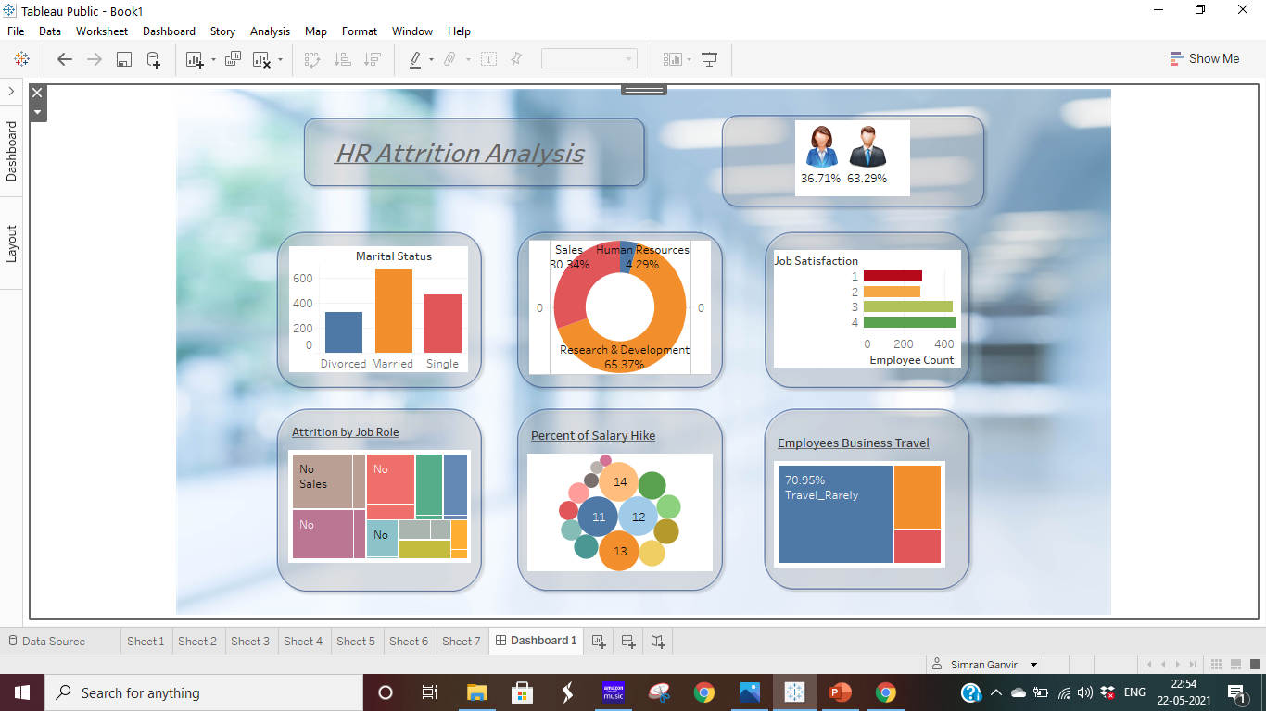

Slide 3
Insights
We noticed that there are more number of male employees.
45.78% employees are married, 31.97% employees are single & 22.24% employees are divorced.
65.37% employees are from research & development, 30.34% are from sales & 4.29% are from human resources.
More of the attritioned employees had job satisfaction below 4.
attrition rate are for 4.22% laboratory technician, 3.88% sales executive , 3.20% research scientist, 2.24% sales representative, 0.82% human resources, 0.68% manufacturing director , 0.61% healthcare representative, 0.14% research director.
Highest are 14.29% employees have salary percent hike of 11%.
70.95% employees travel rarely , 18.84% employees travel frequently & 10.20% employees are non travellers.

Slide 4
Estimate
Sr no | Steps | Rate/Hour | Hours spent | Amount
1 | Data understanding and cleansing. | 150 | 2 | 300
2 | Creating sheets | 300 | 4.5 | 1350
3 | Creating wireframe | 300 | 2 | 600
4 | Insights & Conclusion | 400 | 3 | 1200
 | Total Estimate |  | 11.5 | 3450

